Slide 1


STRINGS
-Tanmay Mittal

Slide 2
CONTENTS
Hashing
Tries
Suffix Array and Kasai Algorithm
Suffix Tries and Trees
Matching Index & Suffix Linking
Creation of Suffix Tries

Slide 3
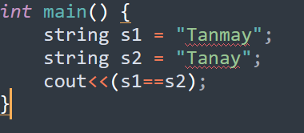

Why do we need a hash?
How much time??

Slide 4
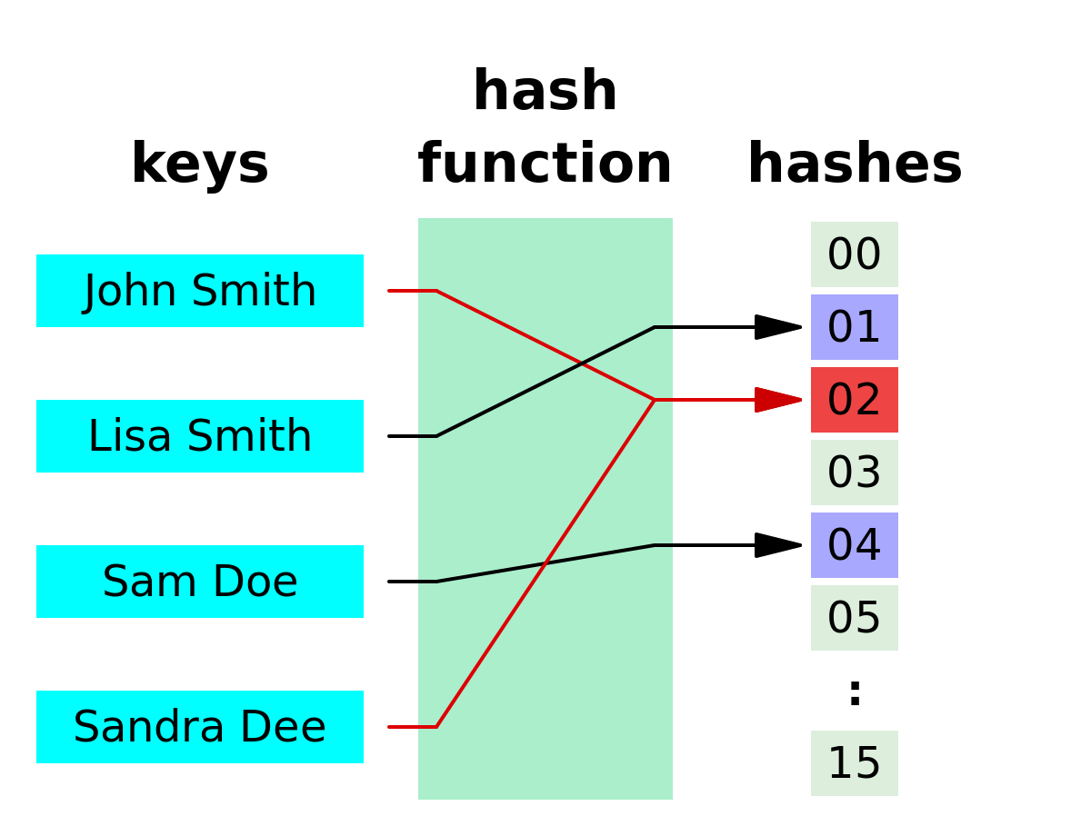
What is a hash?
Map string to int
Small change, large variation in Hash
Many-one Function
Collision, but rarely
Try modulus…….

Slide 5
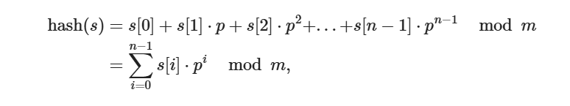
Polynomial Rolling Hash

Slide 6
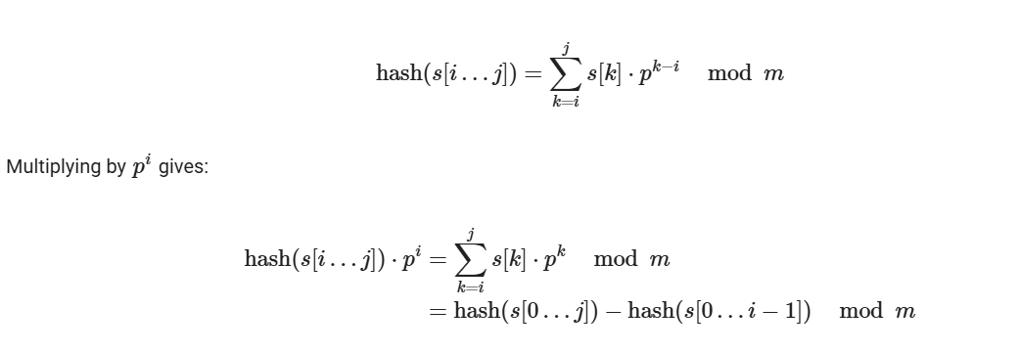
Pre Computing for substring
BUT how to get Prefix-Hashes in O(n) ??

Slide 7
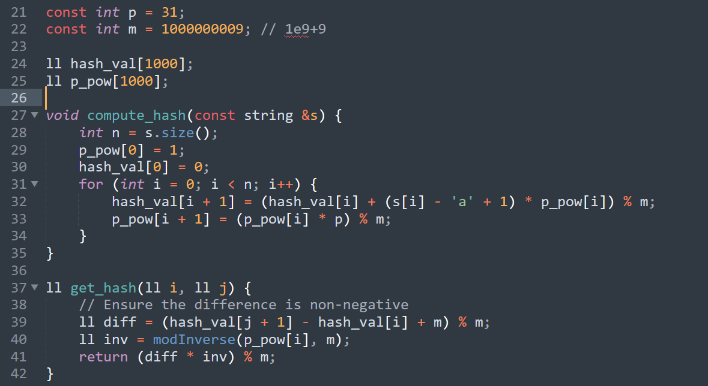
The Complete Code

Slide 8
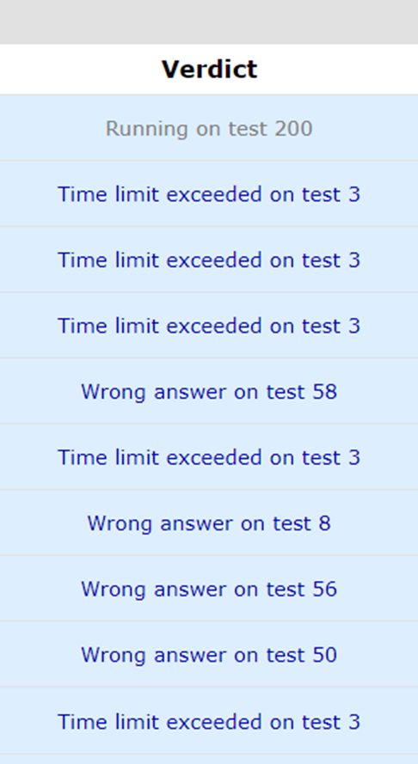
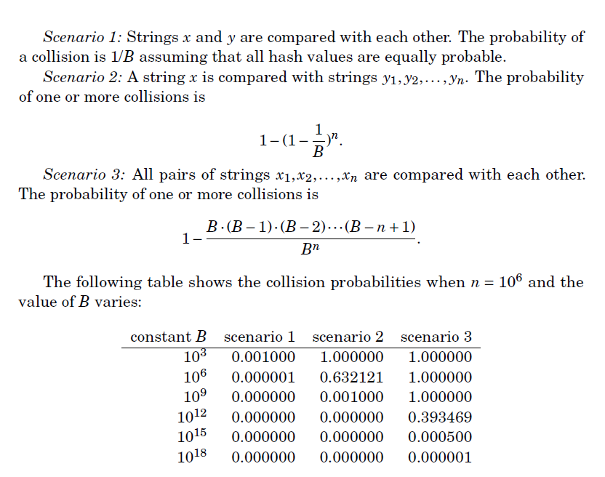
Collisions!

Slide 9
Can we Reduce Collisions !!!
What’s our constraints on m??
Any way to reduce collision chances?
Hint: Square of a small number -> Very small number
Solution: PAIR OF HASHES for 2 values of p

Slide 10
Ancient Rivalry
Shreyans has a string s of length n (<2e5). He decided to remove two consecutive characters from the string but doesn’t inform Dev about it (as always). Dev now wonders how many different strings can be made after such an operation.
Sample:
‘aaabcc’ has four such distinct strings;
‘abcc’
‘aacc’
‘aaac’
‘aabc’

Slide 11
Palindrome Queries
Sushant had gone to propose his crush. But his crush wants to test him by giving him another string S (n<2e5) and tells him to Q queries (q<2e5) of two types :
1 x c -> Change the ‘x’ th character to ‘c’.
2 l r -> Check if the substring S[L:R] is a palindrome.
Help him impress her :)

Slide 12
Another Palindrome Queries
Q) Still not satisfied, his crush wants to test him by giving him another string S (n<2e5) and tells him to find number of index (i,j) such that substring s[i]…. S[j] is a palindrome.
But wait: isn’t n^2 such substrings possible??
How to we even represent the final answer…..
Palindrome[i] = maximum length of palindrome, with ith index as centre
Think Binary Search….
Hashing + BS to find answer in (n * log n)
Manacher’s Algo: O(n) but complicated (Check resources for Link)

Slide 13
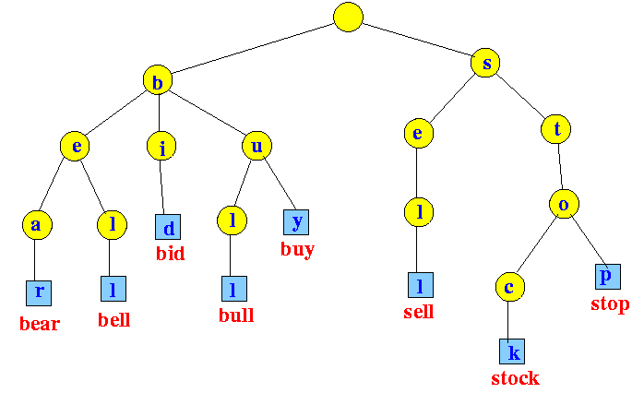
Tries

Slide 14
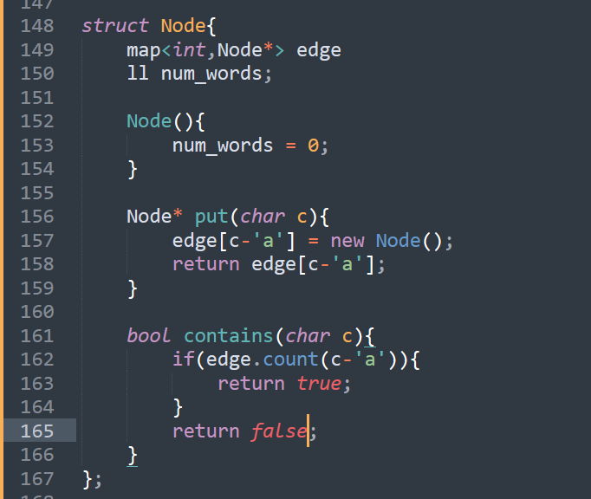
Code!?

Slide 15
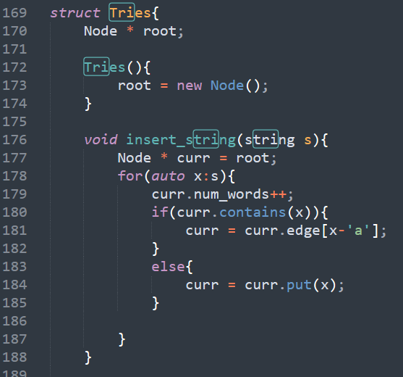
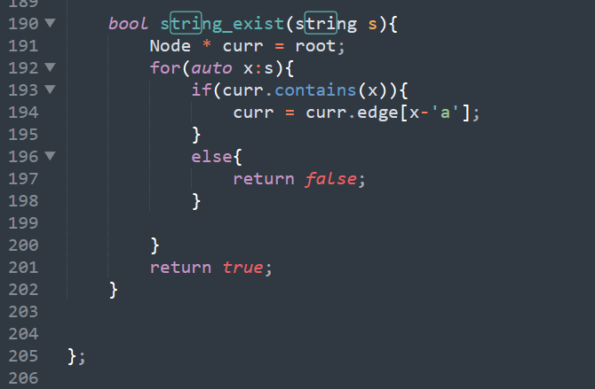

Slide 16
Longest Common Prefix
You are given n strings s1,s2,..sn. FInd the longest common prefix of them.
Sample 1: ‘Tanmay’ ,’Tanay’ , ‘Tanush’ , ‘Tanmoy’, ‘Tanvi’
Ans = 3
Constraints:
0 <= sum(len(si)) <= 1e6
Prefix is a path from root to node of a trie

Slide 17
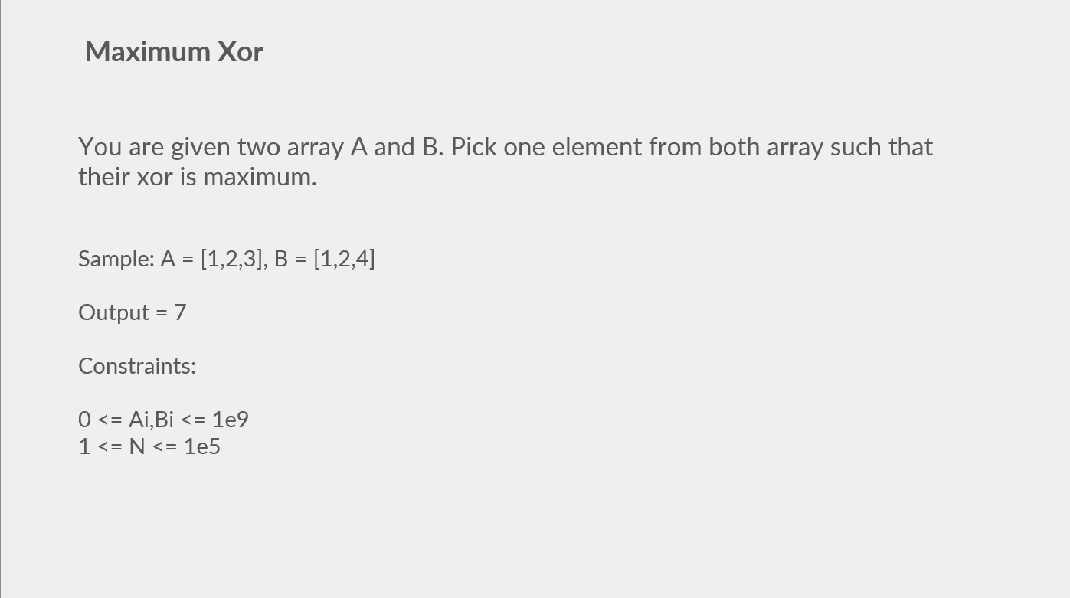

Slide 18
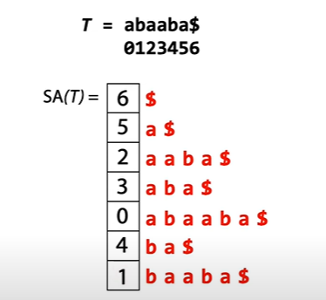
Suffix Arrays
Each suffix can be represented by their starting index. Sort all suffixes and the order of suffixes is called the suffix array of the string.
Can be found using Radix Sort in O(n*k) where k = number of distinct letters in the text.
Possible in O(nlogk) by using dp to iterative compare suffixes of length x using comparisions of suffixes of length (x/2) in O(n).
https://www.youtube.com/watch?v=_TUeAdu-U_k

Slide 19
Applications of Suffix Arrays
Lexographically Smallest Cyclic Shift of a string
Finding substring in a string
Hint: Binary Search
Find Longest Common Prefixes of suffixes of a string (LCP) (longest recurring substring)
Kasai Algorithm in O(n) very Easy from SA
Number of distinct substrings of a strings …..

Slide 20
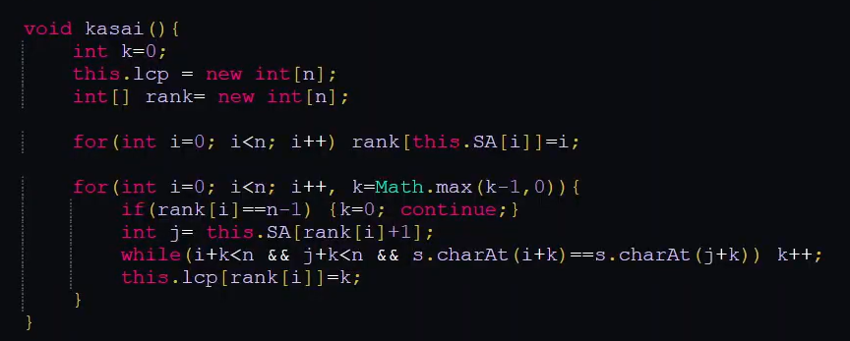
Kasai Algorithm
Based on fact that LCP[suffix from index i+1] can has at minimum , the value of LCP [suffix i] -1;
Rank denote the position of suffix in SA.

Slide 21
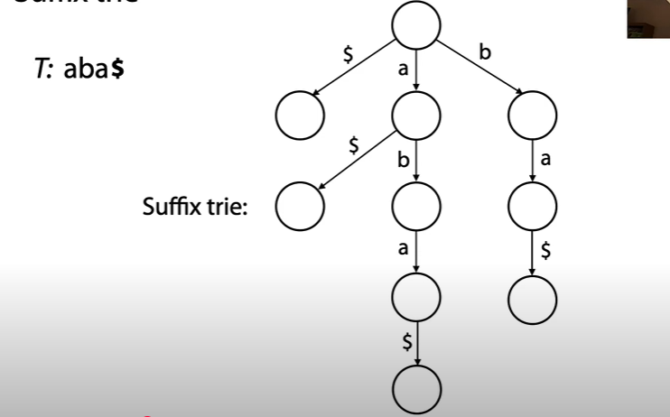
Suffix Tries
Only Prefix matching in Tries
How about substring matching.
Any substring is a prefix of a suffix of the string
So what is the tries contains all the suffixes of a string
Any substring will be a path from root to a node of the suffix-trie

Slide 22
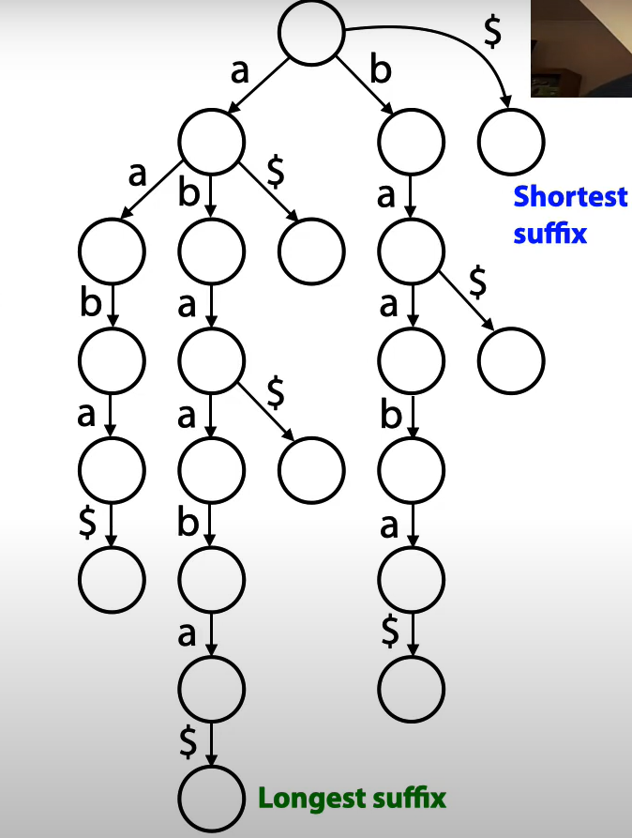

Space Complexity?
Worst Case:
abcdefg$
O(n^2) tends
Time Complexity >= Space Complexity
So No Hopes??

Slide 23
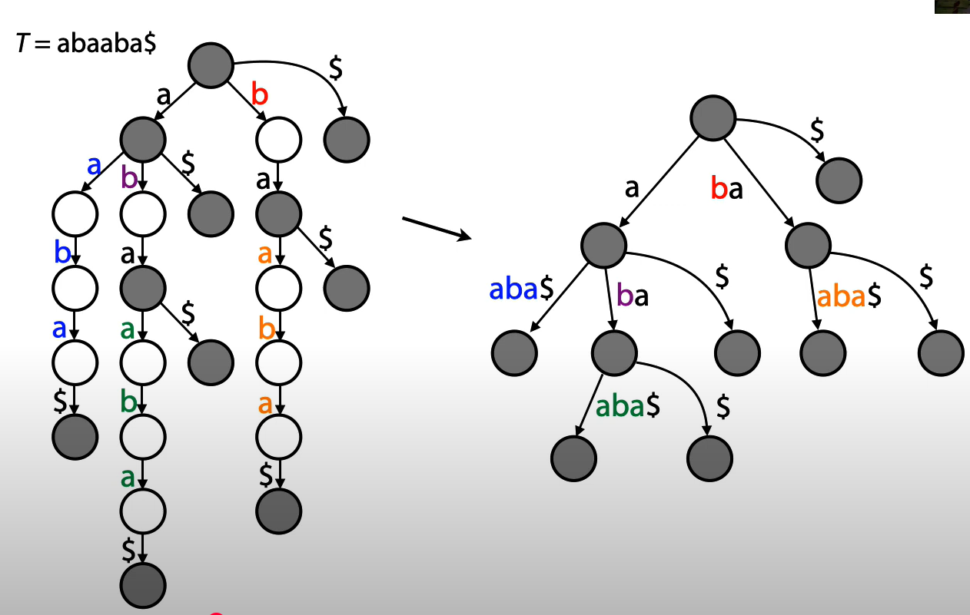
Improving on Suffix Tries
Eliminate All nodes with 1 child only
Can we still say the number of nodes in O(n) ??
Think Binary Tree
Yes. N leaf node (for each suffix) so at max N-1 internal nodes..

Slide 24
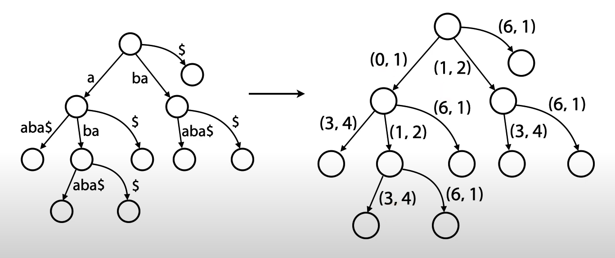
Are we missing something??
What about Edges sizes. O(n) edges with O(n) length each again n^2 memory
But aren’t all edges just a substring of original string
All we need are 2 indexes (i,j) to represent an edge

Slide 25
Applications of Suffix Trees
Exact Pattern Matching : Does a given pattern exist in the tree.
Can also use KMP (see resources) or hashing.
But O(|text size| ) searching complexity, instead of O(|Pattern Size|).
Q) Given a string (S) and a pattern (T). Give the count of number of substring of S which matches T.
Sample:
S = “xyzyyzxyz”
T = “ yz”
As yz occurs 3 times -> 3

Slide 26
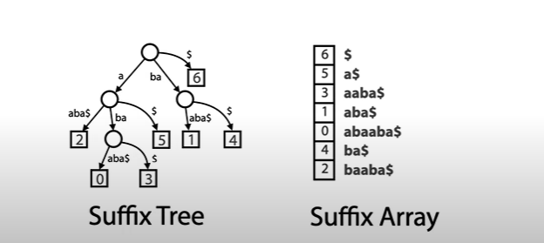
Applications of Suffix Trees
Q) Given 2 strings T and P. Find all substring of P present in T
Again, what do you think is the upper bound on the answer size…..
How can you solve it (we incurred a similar problem before)

Slide 27
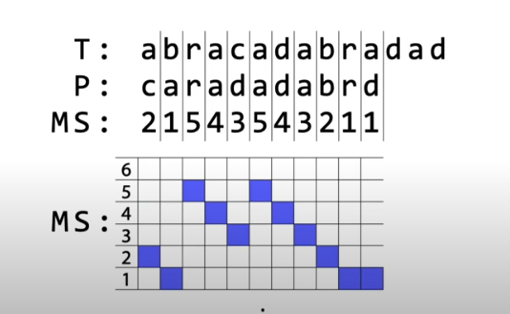
Matching Statistics
MS[i] = no of j such that P[i:j] is present in the substring
Observe pattern, increase and then decrease
Peaks are called Maximal Exact Matches

Slide 28
Still how to we find all substrings…
T = abababa$
P = babbb$
We create suffix tree of T and start matching P on the tree…
We matched bab but couldn’t babb substring
So now we ignore the 1ˢᵗ b and start finding substrings starting from ab. But don’t want to match ab again.
bab matching to ab matching -> SUFFIX LINKS

Slide 29
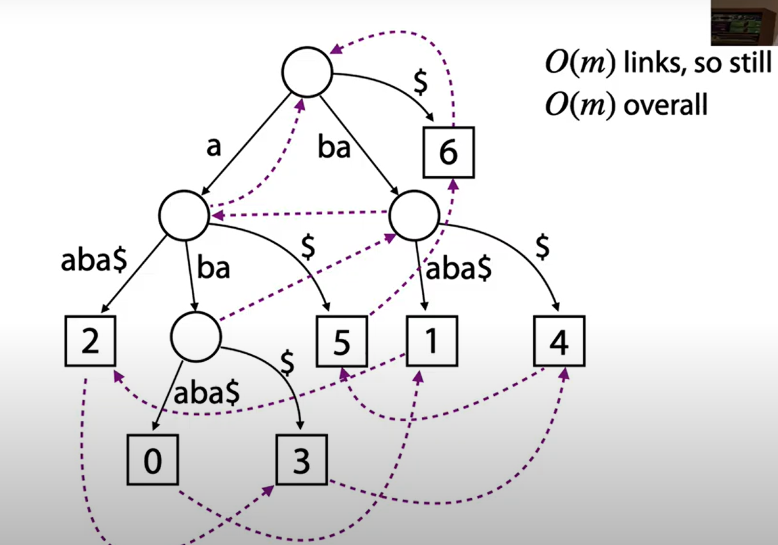
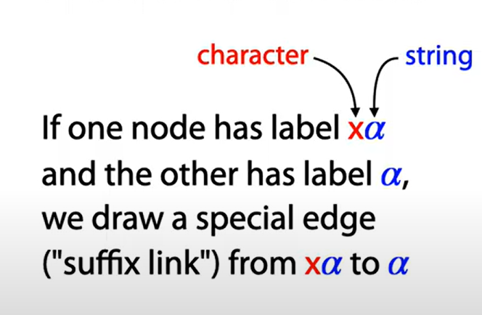
Suffix Links

Slide 30
But how to find Suffix Links ??
Each node has a representative string → Hash and store the string for each node in map and then make Suffix Links
O(n) algorithms for suffix trees
Using Suffix Arrays and LCP
Ukkonen’s Algorithm (implicitly creates and uses Suffix Links during constructions itself)
Remember templates are allowed in ICPC

Slide 31
Using Suffix Arrays and LCP
Each Suffix is a leaf of the Suffix Tree. LCP corresponding to 2 adjacent Suffix is the depth of LCA of the 2 leaves in the Suffix Tree
Start From LCA nodes of least depth and recursively build the tree.
Code
Explanation

Slide 32
Ukkonen’s Algorithm
Code_Link
Visualiser
Explanation & Explanation 2

Slide 33
Bonus Resources:
KMP algorithm:
https://cp-algorithms.com/string/prefix-function.html
https://www.youtube.com/watch?v=JoF0Z7nVSrA
Manacher’s algorithm:
https://www.youtube.com/watch?v=V-sEwsca1ak
https://yuminlee2.medium.com/manachers-algorithm-longest-palindromic-substring-cc97fa615f8b
Tries Practice Problem:
https://codeforces.com/blog/entry/75302
Suffix Arrays Practice Problems:
https://cp-algorithms.com/string/suffix-array.html

Slide 34
Thank You :)

